Slide 1

Dacon 8th KCB Visualization Competition
-EDA-
YILGUK SEO
roal214@naver.com

Slide 2
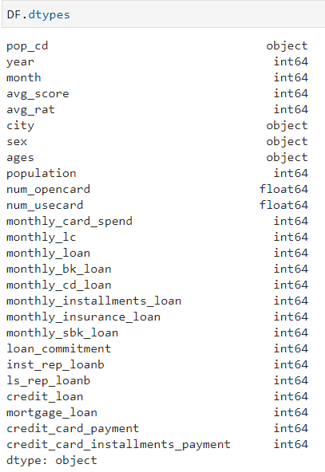
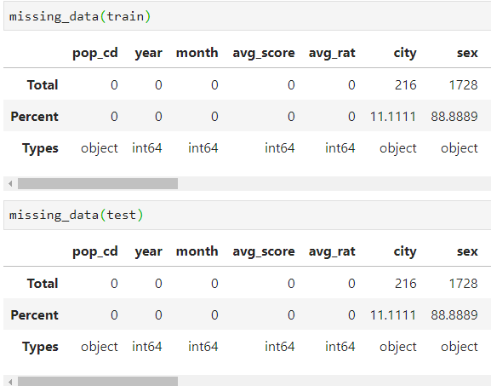
Need imputation issue here
Categorical variables : month, city, sex, ages

Slide 3
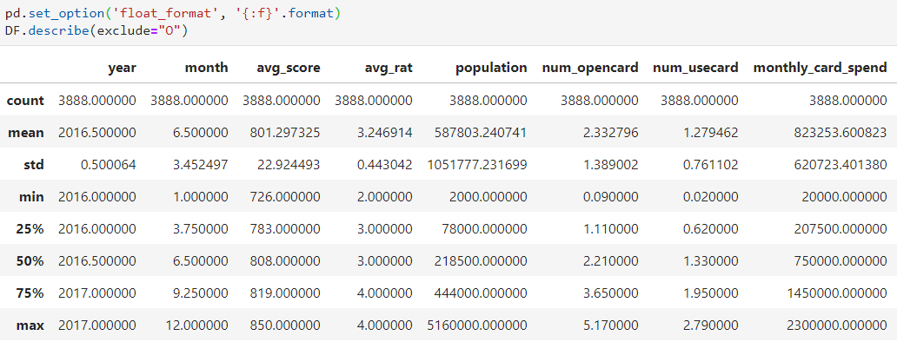
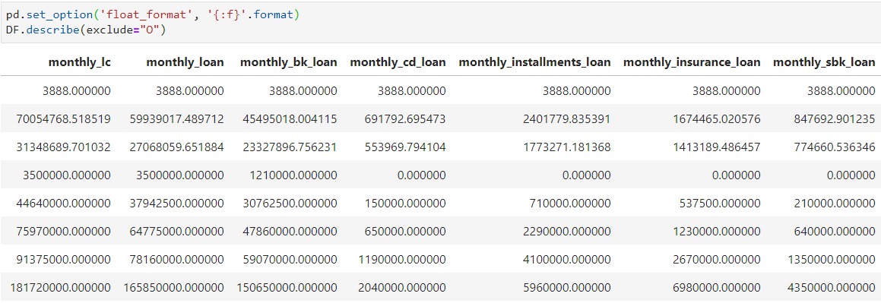
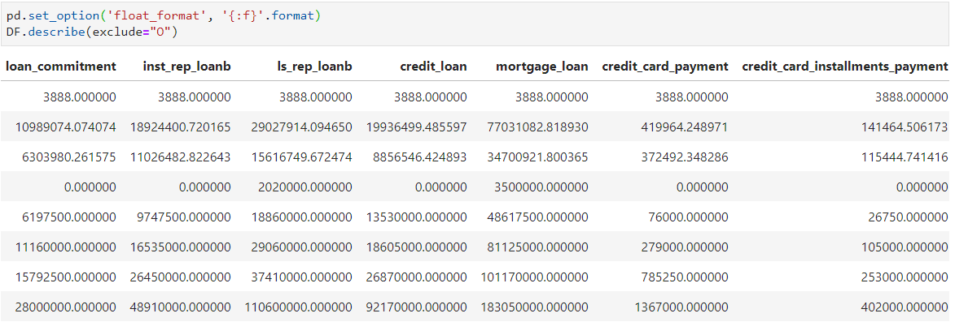
filter weirdness by describe()
Easily see the weirdness of many columns having large STD

Slide 4
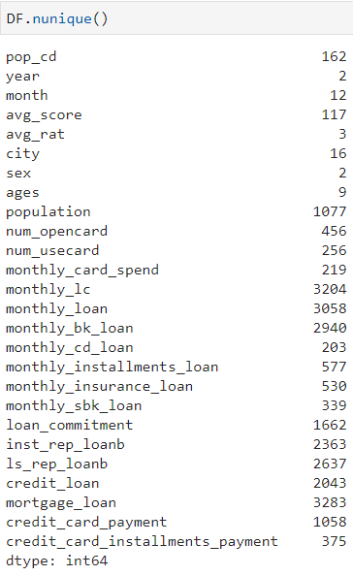
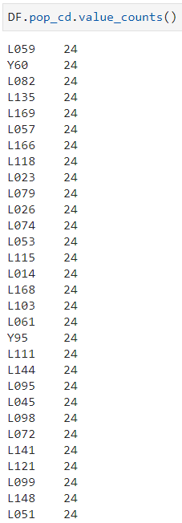
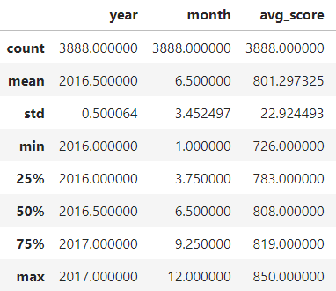
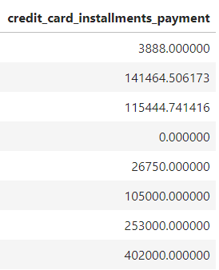
filter weirdness by describe()
Equally 24

Slide 5
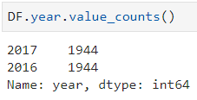
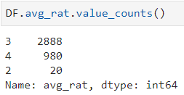
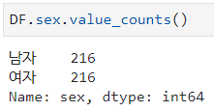
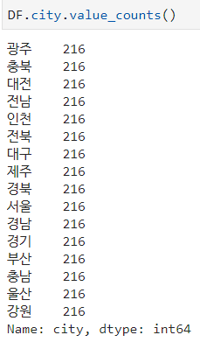
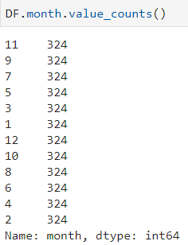
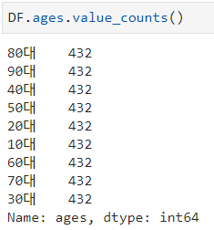
Train/Test the same rows
avg_rat
[Description – avg_rat]
고객구분 코드 그룹의 평균 등급
※ 등급 및 평점의 평균은 소숫점 첫째 자리에서 반올림하여 정수 형태로 제공하였음
Sex
month
City
Ages

Slide 6
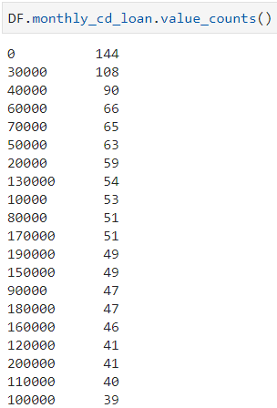
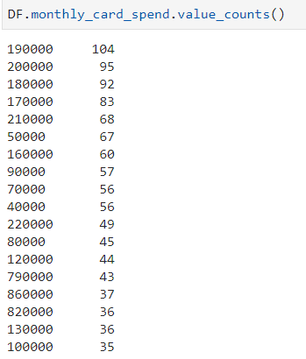
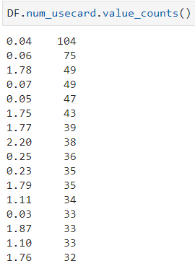
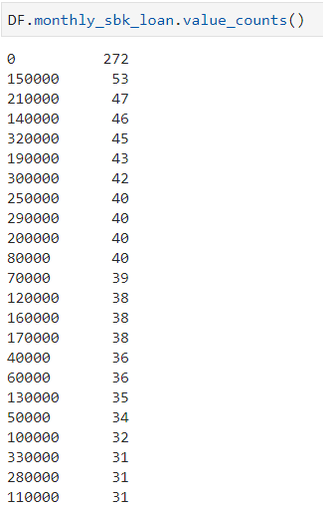
monthly_cd_loan
monthly_card_spend
num_usecard
monthly_sbk_loan
[Description – monthly_cd_loan]
카드업종으로부터 KCB에 등록된 대출개설정보 중 개인대출정보의 대출금액의 합
[Description – monthly_sbk_loan]
저축은행업종으로부터 KCB에 등록된 대출개설정보 중 개인대출정보의 대출금액의 합

Slide 7
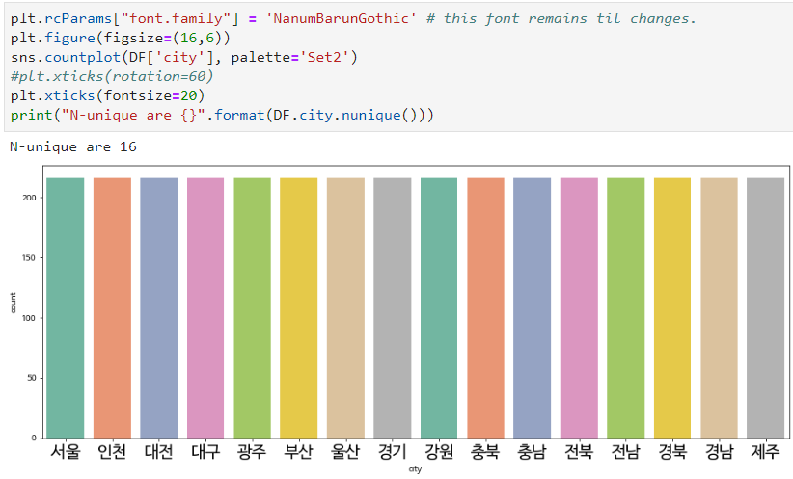
City countplot

Slide 8
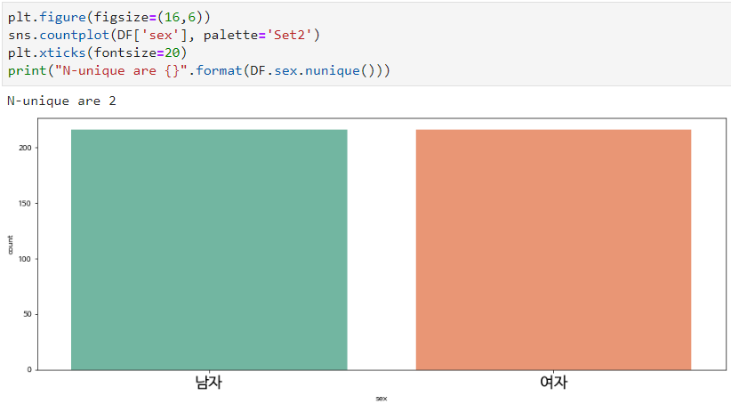
sex countplot

Slide 9
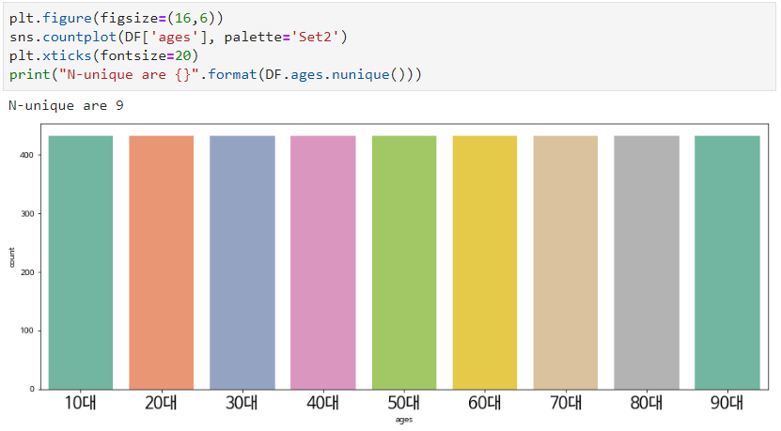
ages countplot

Slide 10
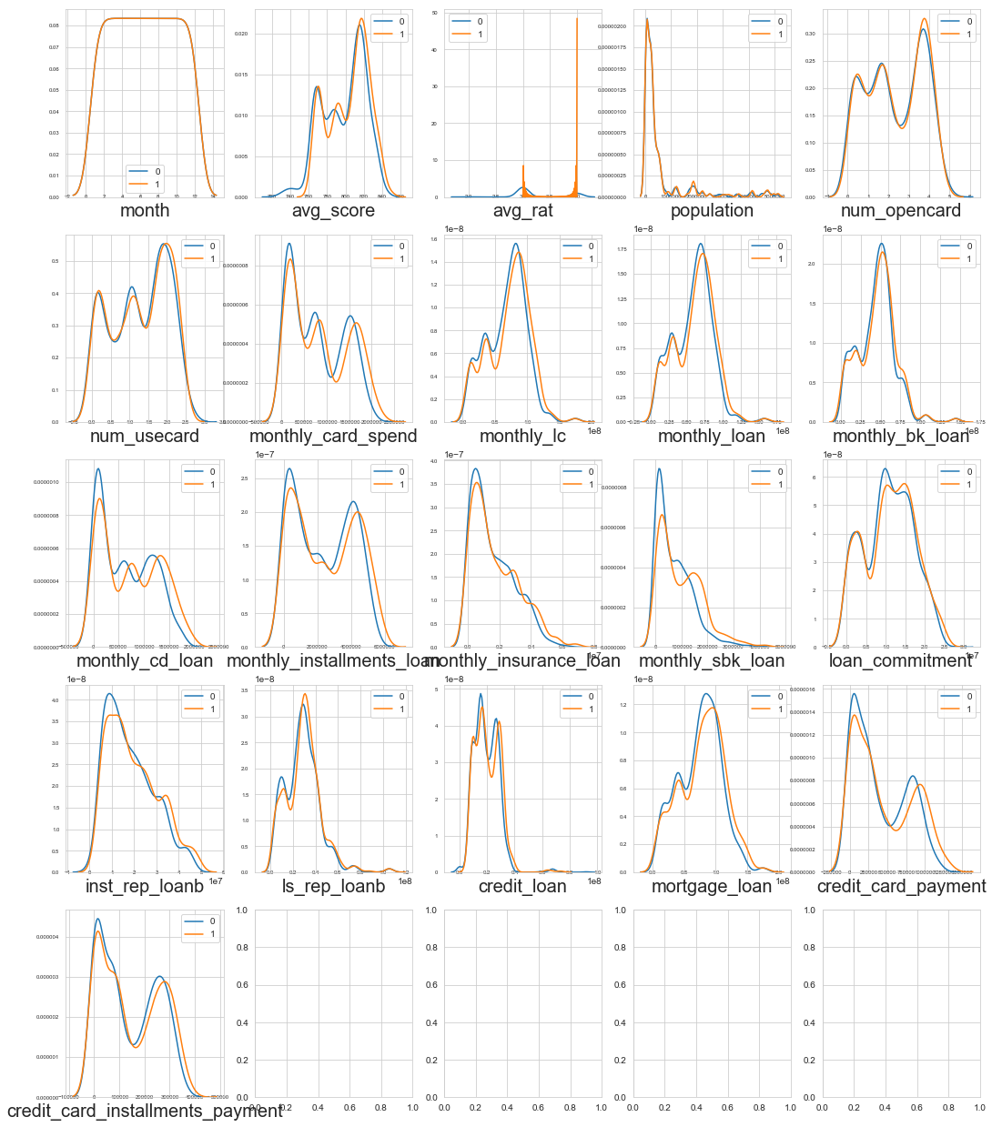
Feature distribution

Slide 11
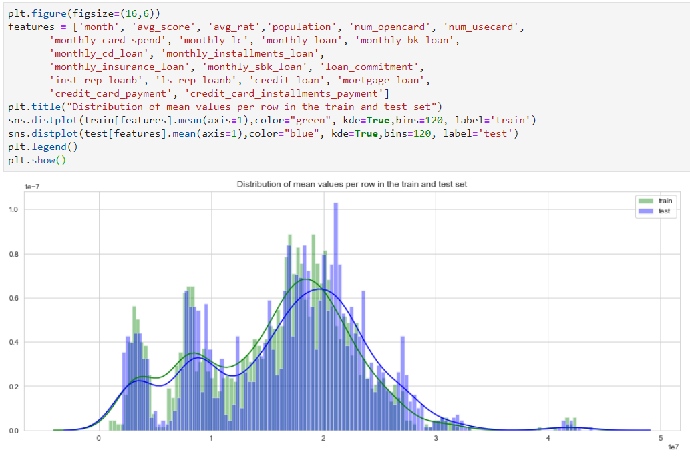
distribution

Slide 12
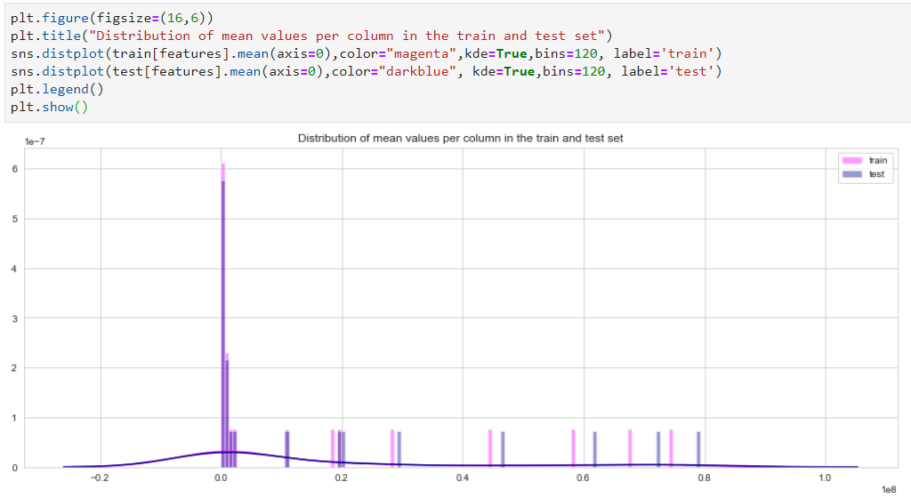
distribution

Slide 13
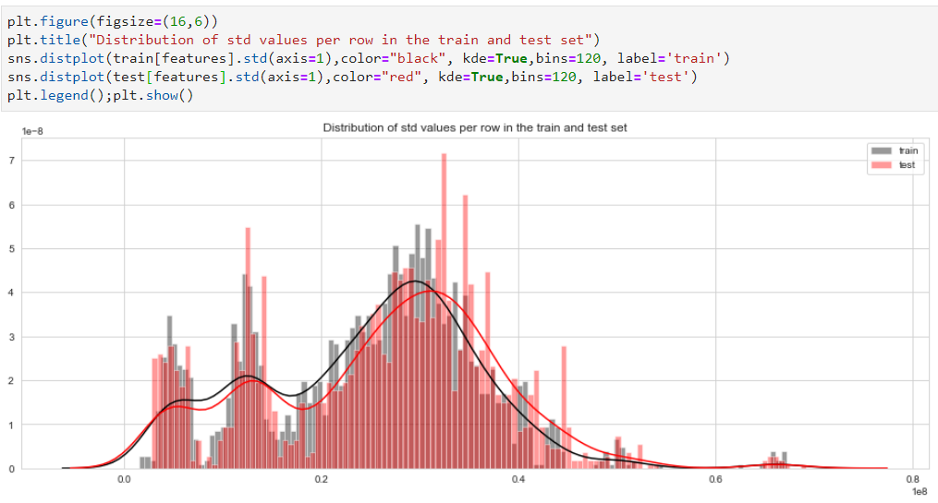
distribution

Slide 14
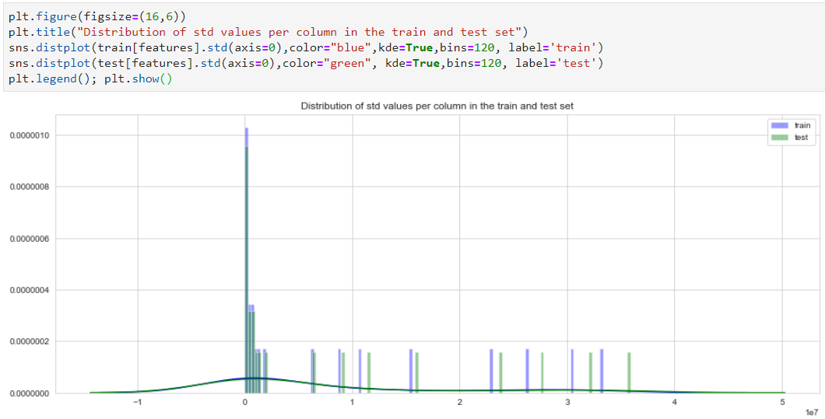
distribution

Slide 15
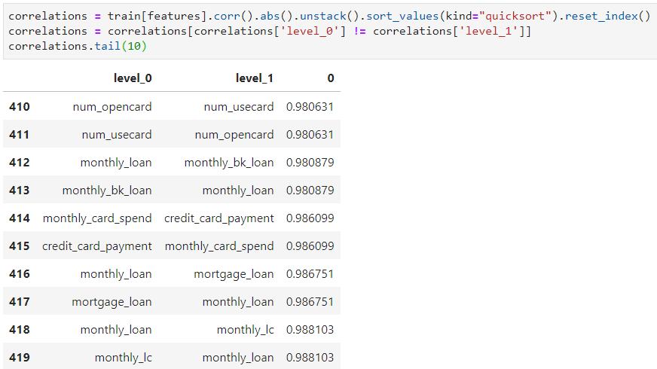
Feature
Corr

Slide 16
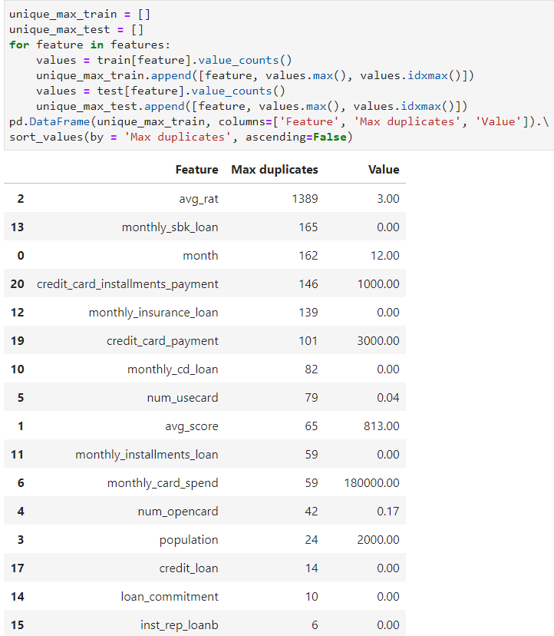
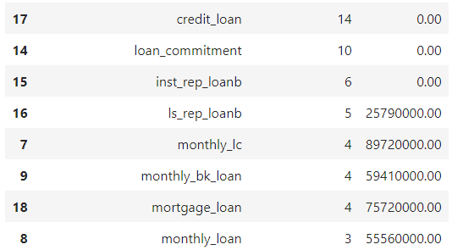
Feature
Corr

Slide 17
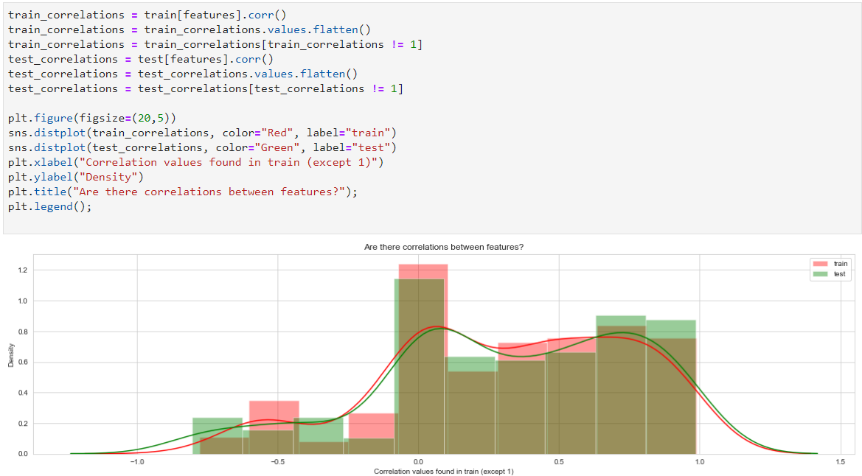
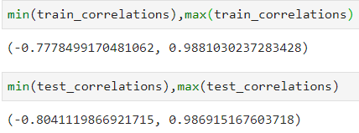
Feature
Corr
Looks linear

Slide 18
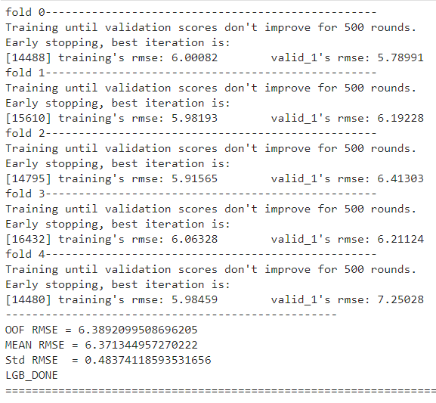
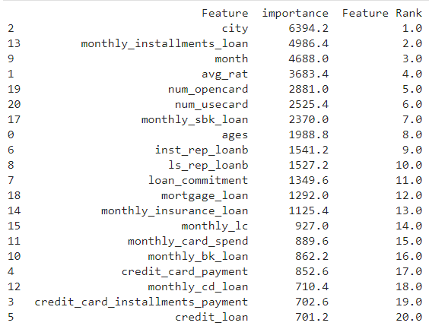
Base
Model

Slide 19
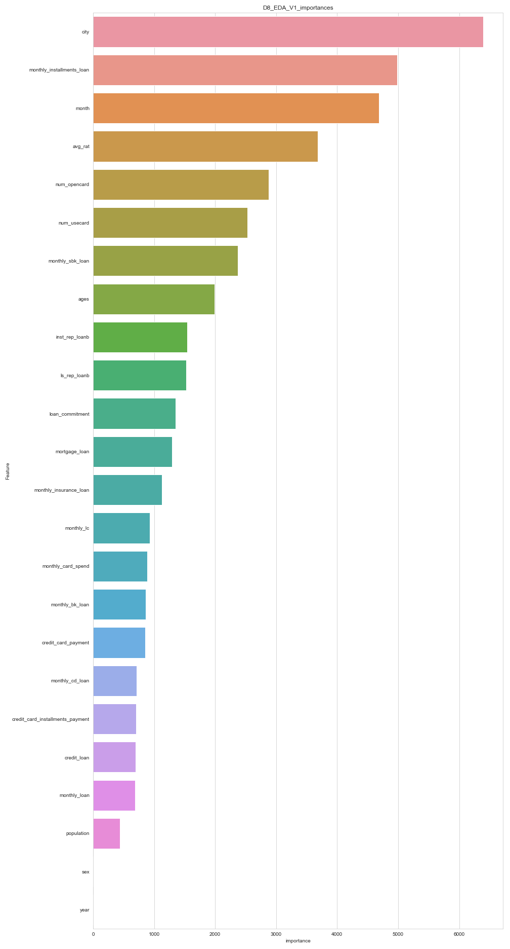
Base
Model

Slide 20
Base
Model
What I noticed from this are:
city – quite plausible that people’s credit rating are related income level of themselves.
Big cities are prone to have people having robust credit rating.
monthly_installments_loan
[monthly_installments_loan]
할부금융업종으로부터 KCB에 등록된 대출개설정보 중 개인대출정보의 대출금액의 합
monthly_installments_loan
– monthly sum of loan is intuitively related.
month
I don’t know why month are related yet.
Look forward to understand this. (relationship between avg_score and month)
avg_rat
This is designated by avg_score
[monthly_sbk_loan]
저축은행업종으로부터 KCB에 등록된 대출개설정보 중 개인대출정보의 대출금액의 합
monthly_sbk_loan
– monthly sum of loan is intuitively related.
inst_rep_loanb
– monthly sum of loan is intuitively related.
[inst_rep_loanb]
KCB에 등록된 대출개설정보 중 거래형태코드가 분할상환(원리금균등,원금균등,거치상환등)으로 등록된 개인대출정보 대출잔액의합

Slide 21
Base
Model
What I noticed from this are:
ls_rep_loanb
– monthly sum of loan is intuitively related.
[ls_rep_loanb]
KCB에 등록된 대출개설정보 중 거래형태코드가 일시상환으로 등록된 개인대출정보 대출잔액의합

Slide 22
Base
Model
city – quite plausible that people’s credit rating are related income level of themselves.
Big cities are prone to have people having robust credit rating.
monthly_installments_loan
[monthly_installments_loan]
할부금융업종으로부터 KCB에 등록된 대출개설정보 중 개인대출정보의 대출금액의 합
Model Developments
monthly_installments_loan
– monthly sum of loan is intuitively related.
CITY – assumed to be an income related factor
Grouping city
City to be categorical_feature
monthly_installments_loan – most common loans
MONTH - ??
KCB updates every 15th and last day of the month
month to be categorical_feature
monthly_sbk_loan – 제2금융 대출금액
inst_rep_loanb – 분할상환 대출잔액
ls_rep_loanb – 일시상환 대출잔액
loan_commitment – 한도대출 대출잔액
mortgage_loan – 담보대출 대출금액
monthly_insurance_loan – 보험업종 대출금액
monthly_lc – 대출약정금액
monthly_card_spend
month
I don’t know why month are related yet.
Look forward to understand this. (relationship between avg_score and month)
avg_rat
This is designated by avg_score
[monthly_sbk_loan]
저축은행업종으로부터 KCB에 등록된 대출개설정보 중 개인대출정보의 대출금액의 합
monthly_sbk_loan
– monthly sum of loan is intuitively related.
inst_rep_loanb
– monthly sum of loan is intuitively related.
[inst_rep_loanb]
KCB에 등록된 대출개설정보 중 거래형태코드가 분할상환(원리금균등,원금균등,거치상환등)으로 등록된 개인대출정보 대출잔액의합

Slide 23
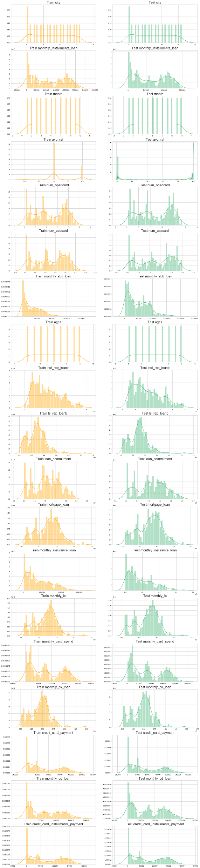
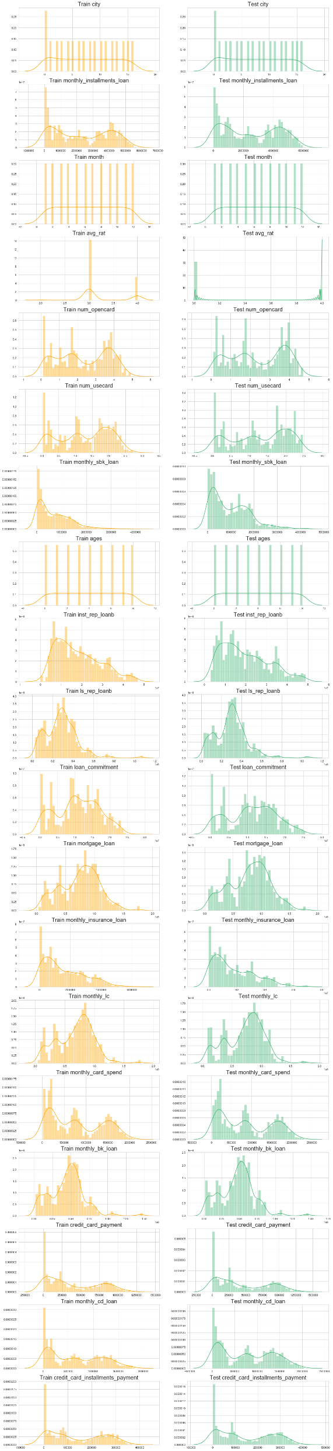
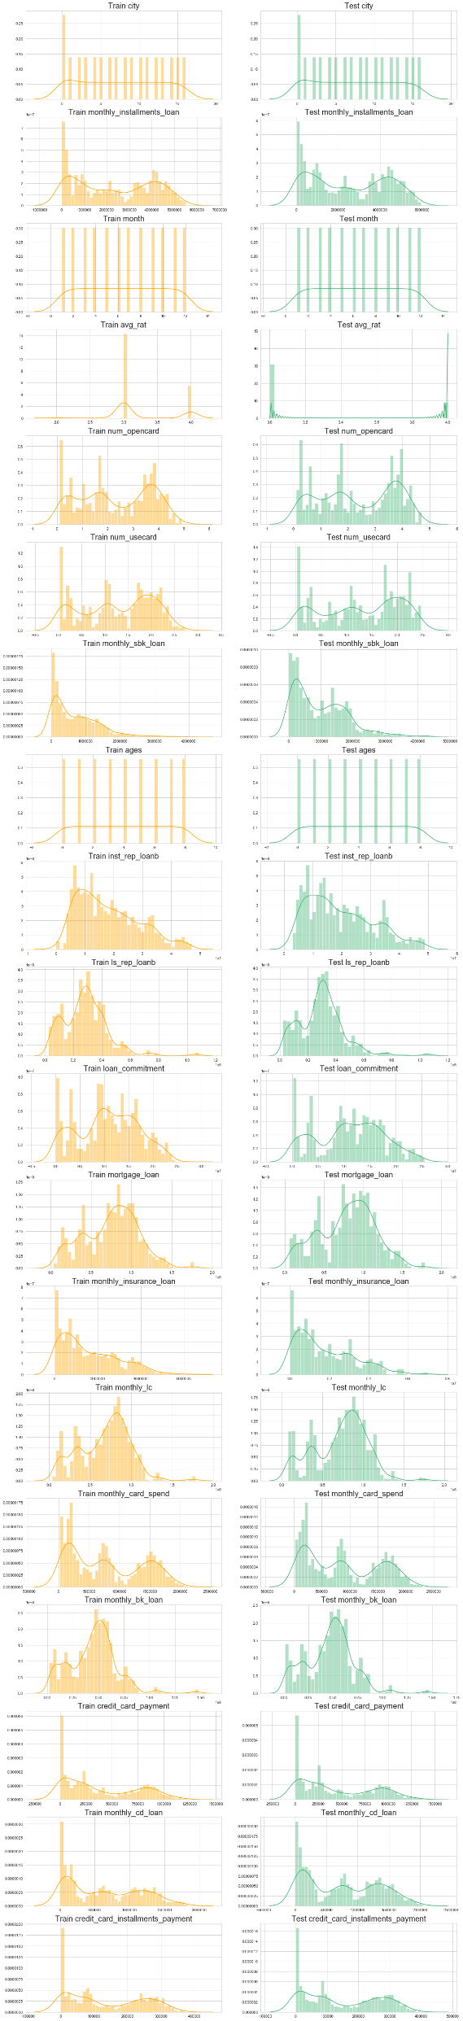
Base
Model
Base Model Top Features

Slide 24
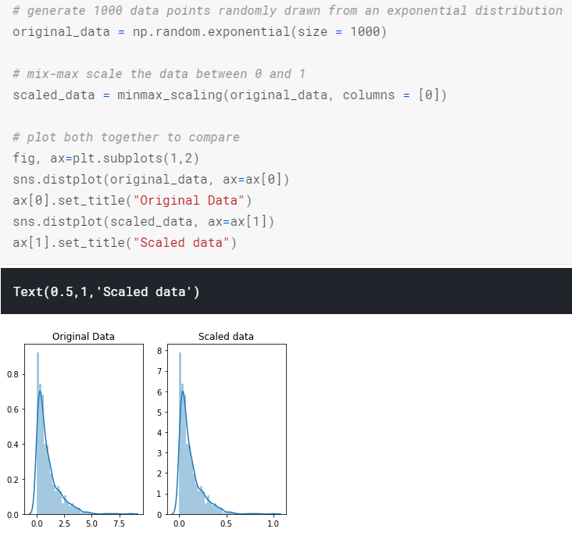
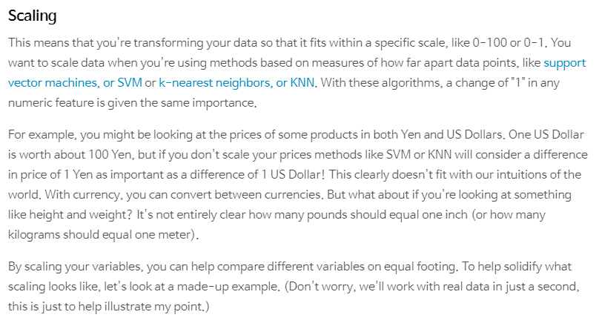
DATA Cleaning
Easily see the weirdness of many columns having large STD
To handle this issue, Scaling and Normalization are needed.
Let’s DO BOTH and See what will produce better results
Shapes are the same

Slide 25
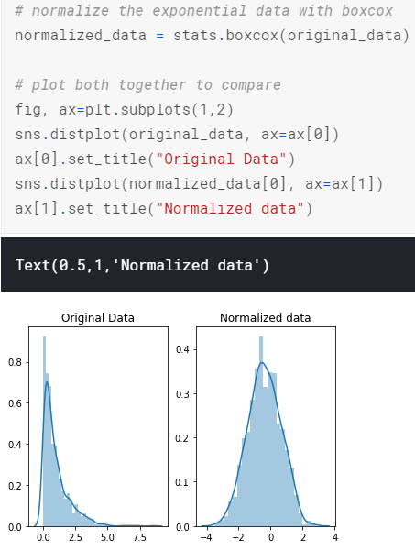
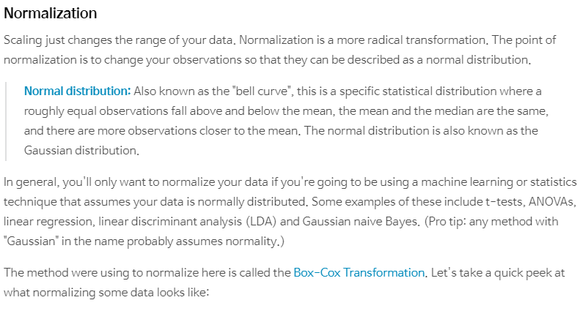
DATA Cleaning
Easily see the weirdness of many columns having large STD
To handle this issue, Scaling and Normalization are needed.
Let’s DO BOTH and See what will produce better results
Shapes are changed

Slide 26
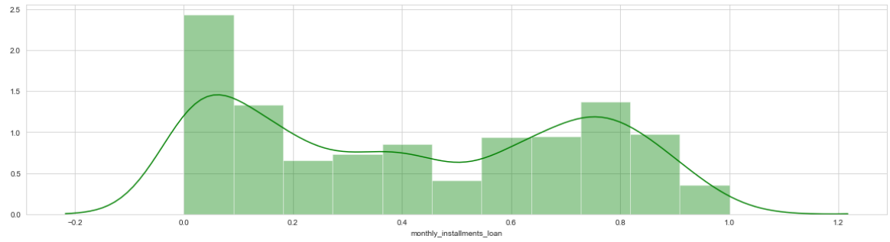
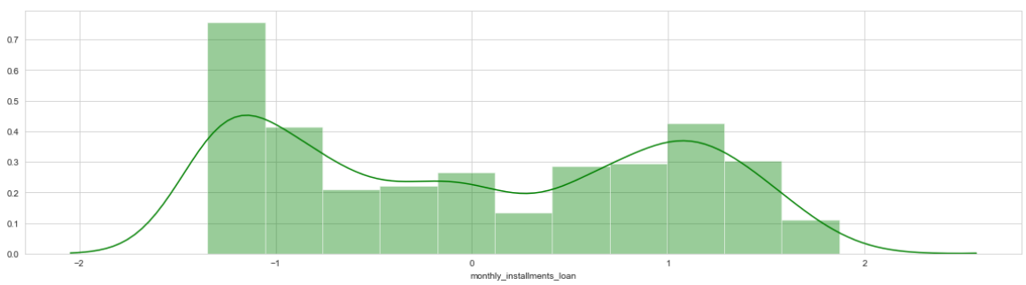
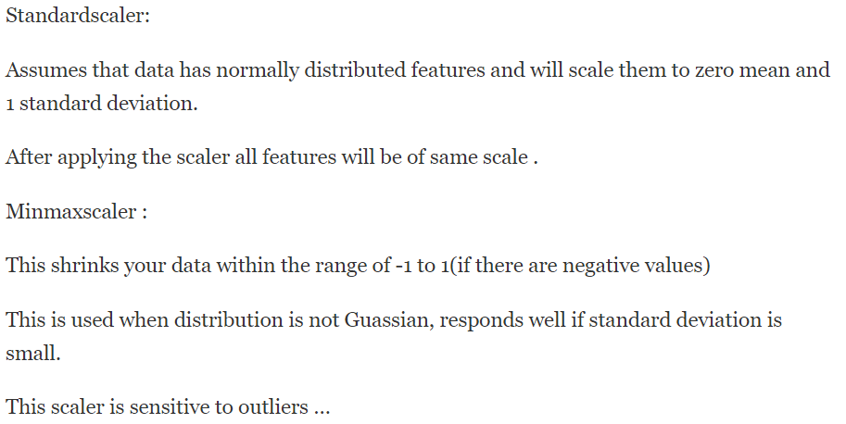
DATA Cleaning
StandardScaler & minmaxScaler
preprocessing.MinMaxScaler
scaler = MinMaxScaler()
scaler.fit(train_X)
scaled_train_X = pd.DataFrame(scaler.transform(train_X), columns=train_X.columns)
preprocessing.StandardScaler
scaler = StandardScaler()
scaler.fit(train_X)
scaled_train_X = pd.DataFrame(scaler.transform(train_X), columns=train_X.columns)

Slide 27
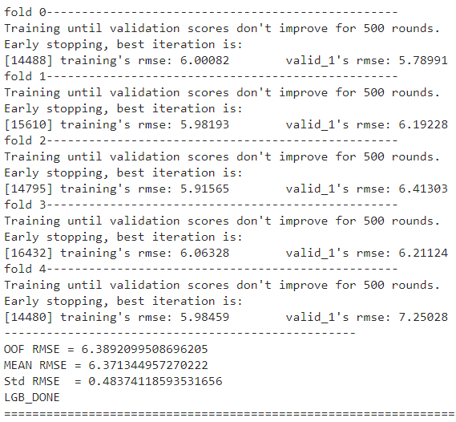
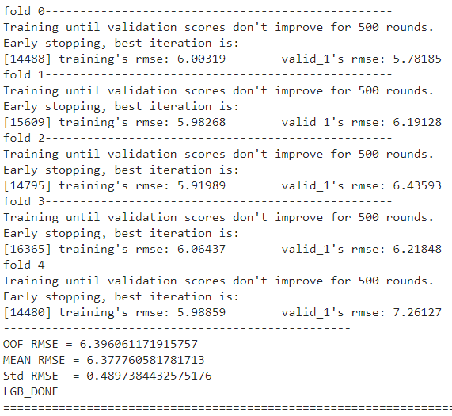
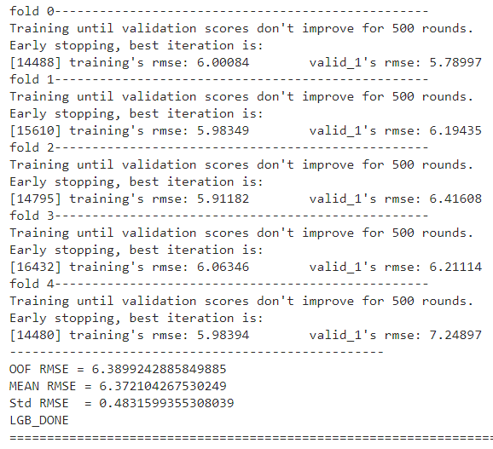
DATA Cleaning
Scaler
Before StandardScaler
After StandardScaler
After MinMaxScaler
slightly worsen
MinMaxScaler is better than standard

Slide 28
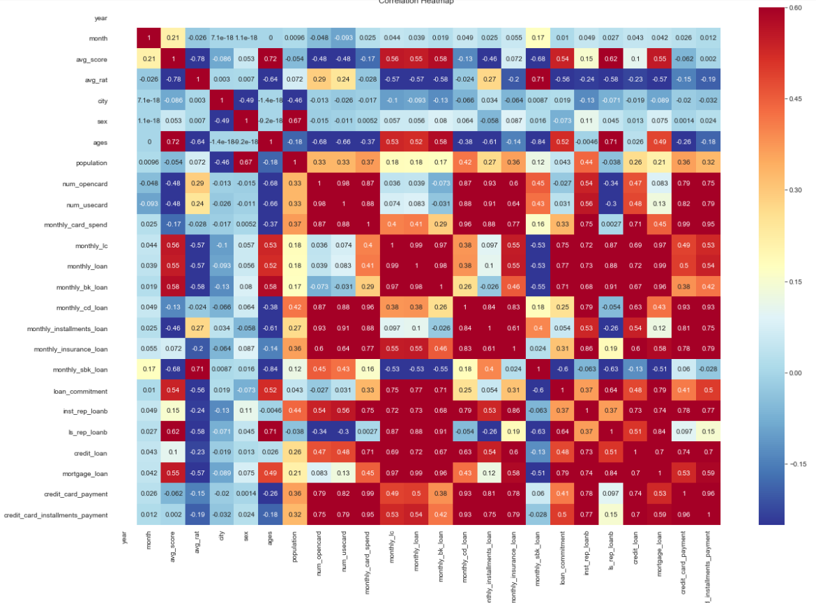
Base
Model
Heatmap
corr_data = train[['year', 'month', 'avg_score', 'avg_rat', 'city', 'sex',
'ages', 'population', 'num_opencard', 'num_usecard',
'monthly_card_spend', 'monthly_lc', 'monthly_loan’,
'monthly_bk_loan',
'monthly_cd_loan', 'monthly_installments_loan',
'monthly_insurance_loan', 'monthly_sbk_loan', 'loan_commitment',
'inst_rep_loanb', 'ls_rep_loanb', 'credit_loan', 'mortgage_loan',
'credit_card_payment', 'credit_card_installments_payment']]
corr_data_corrs = corr_data.corr()
plt.figure(figsize = (20, 14))
# Heatmap of correlations
sns.heatmap(corr_data_corrs, cmap = plt.cm.RdYlBu_r, vmin = -0.25, annot = True, vmax = 0.6)
plt.title('Correlation Heatmap');

Slide 29
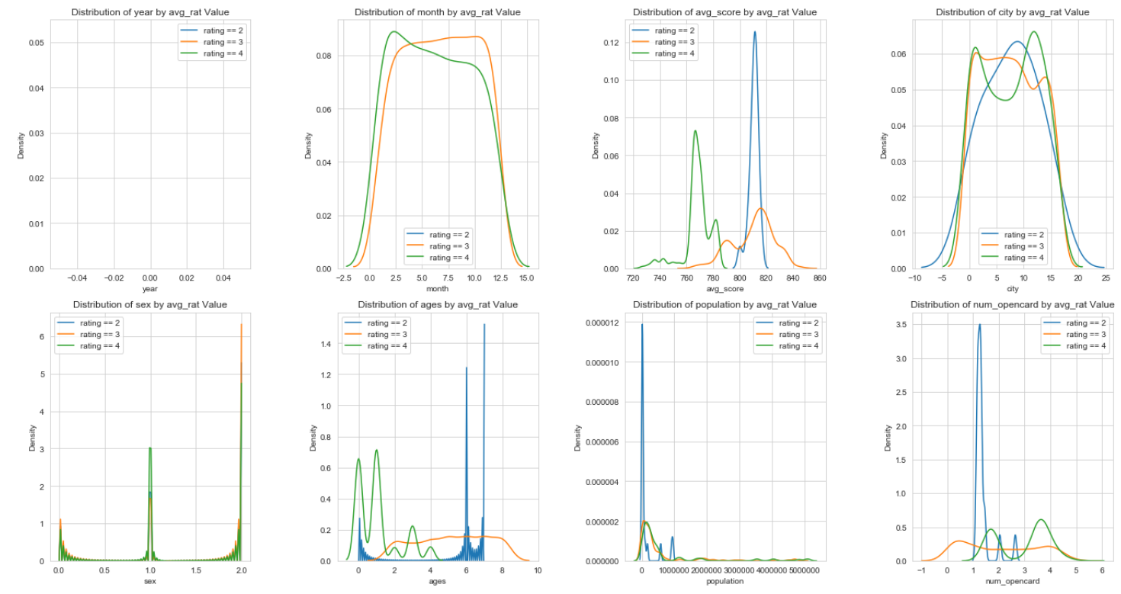
Base
Model
KDEPLOT by Rating

Slide 30

Base
Model
KDEPLOT by Rating

Slide 31

Base
Model
KDEPLOT by Rating

Slide 32

Credit rating table

Slide 33
Base
Model
Model Creating IDEA
model separate by city, month, avg_rat then ensemble
See the changes
by month(lag)
how they changed their credit score or rating (better or worsen)
and display this with D3.js
In Korea, Many people uses monthly_installments_loan and
monthly loans ratio by banks or card

Slide 34
Base
Model
Fearture Engineering IDEAs
Difference, changes, regions, times, types,
Differences
(abs-diff)
(sum of same)
Groups
CITY
loan(금액) & loan(잔액) & payment
Loan Types
monthly_installments_loan
monthly_sbk_loan
inst_rep_loanb
ls_rep_loanb
loan_commitment
mortgage_loan
monthly_insurance_loan
monthly_lc
spending & loan
monthly_card_spend
credit_card_payment
credit_card_installments_payment
Rest of loans
Changes
Months
monthly_installments_loan
monthly_sbk_loan
inst_rep_loanb
ls_rep_loanb
Regions
City
month
Time
Month
month
Quarter
Half
Types
credit_card
loan

Slide 35

DATA
months are from 1 to 12 every same pop_cd
pop_cd
ex L011 means region no.01 and age 10-19
L01 | 1(0)
L011(0)

Slide 36
DATA
(['L011',
'L012',
'L013',
'L014',
'L015',
'L016',
'L017',
'L018',
'L019',
'L021',
'L022',
'L023',
'L024',
'L025',
'L026',
'L027',
'L028',
'L029',
'L071',
'L072',
'L073',
'L074',
'L075',
'L076',
'L077',
'L078',
'L079',
'L081',
'L082',
'L083',
'L084',
'L085',
'L086',
'L087',
'L088',
'L089',
'L091',
'L092',
'L093',
'L094',
'L095',
'L096',
'L097',
'L098',
'L099',
'L101',
'L102',
'L103',
'L104',
'L105',
'L106',
'L107',
'L108',
'L109',
'L111',
'L112',
'L113',
'L114',
'L115',
'L116',
'L117',
'L118',
'L119’,
'L121',
'L122',
'L123',
'L124',
'L125',
'L126',
'L127',
'L128',
'L129',
'L131',
'L132',
'L133',
'L134',
'L135',
'L136',
'L137',
'L138',
'L139',
'L141',
'L142',
'L143',
'L144',
'L145',
'L146',
'L147',
'L148',
'L149',
'L151',
'L152',
'L153',
'L154',
'L155',
'L156',
'L157',
'L158',
'L159',
'L161',
'L162',
'L163',
'L164',
'L165',
'L166',
'L167',
'L168',
'L169'],
Region X Ages Data
Ages X Sex Data
'L031',
'L032',
'L033',
'L034',
'L035',
'L036',
'L037',
'L038',
'L039',
'L041',
'L042',
'L043',
'L044',
'L045',
'L046',
'L047',
'L048',
'L049',
'L051',
'L052',
'L053',
'L054',
'L055',
'L056',
'L057',
'L058',
'L059',
'L061',
'L062',
'L063',
'L064',
'L065',
'L066',
'L067',
'L068',
'L069',
9*2*12 = 216 rows
row = (age)(sex)(month)
16*9*12 = 1728 rows
row = (city)(age)(month)
['Y10',
'Y15',
'Y20',
'Y25',
'Y30',
'Y35',
'Y40',
'Y45',
'Y50',
'Y55',
'Y60',
'Y65',
'Y70',
'Y75',
'Y80',
'Y85',
'Y90',
'Y95'])

Slide 37


DATA DIVISION
MODEL
RA_MODEL
AS_MODEL

Slide 38


DATA DIVISION
MODEL
RA_MODEL
AS_MODEL

Slide 39


DATA DIVISION
RA_MODEL_notop3
AS_MODEL _notop3

Slide 40


DATA DIVISION
RA_MODEL_notop3
AS_MODEL _notop3

Slide 41
Base
Model
Fearture Engineering IDEAs
Difference, changes, regions, times, types,
Differences
(abs-diff)
(sum of same)
Groups
CITY
loan(금액) & loan(잔액) & payment
Loan Types
monthly_installments_loan
monthly_sbk_loan
inst_rep_loanb
ls_rep_loanb
loan_commitment
mortgage_loan
monthly_insurance_loan
monthly_lc
spending & loan
monthly_card_spend
credit_card_payment
credit_card_installments_payment
Rest of loans
Changes
Months
monthly_installments_loan
monthly_sbk_loan
inst_rep_loanb
ls_rep_loanb
Regions
City
month
Time
Month
month
Quarter
Half
Types
credit_card
loan

Slide 42
Diff_MODEL

Slide 43
DATA DIVISION
MODEL
New features
Differences
(abs-diff)
(sum of same)
Groups
CITY
loan(금액) & loan(잔액) & payment
Loan Types
monthly_installments_loan
monthly_sbk_loan
inst_rep_loanb
ls_rep_loanb
loan_commitment
mortgage_loan
monthly_insurance_loan
monthly_lc
spending & loan
monthly_card_spend
credit_card_payment
credit_card_installments_payment
Sum of 금액, 잔액, payment
금액
monthly_installments_loan
monthly_sbk_loan
monthly_lc
monthly_loan
monthly_insurance_loan
loan_commitment
credit_loan
mortgage_loan
잔액
inst_rep_loanb
ls_rep_loanb
payment
credit_car_payment
credit_card_installments_payment
monthly_card_spend
sum of all Three
diff of sum of 금액, 잔액, payment

Slide 44
DATA DIVISION
MODEL
New features
Diff_
MODEL
Differences
(abs-diff)
(sum of same)
Groups
CITY
loan(금액) & loan(잔액) & payment
금액
monthly_installments_loan
monthly_sbk_loan
monthly_lc
monthly_loan
monthly_insurance_loan
loan_commitment
credit_loan
mortgage_loan
잔액
inst_rep_loanb
ls_rep_loanb
payment
credit_car_payment
credit_card_installments_payment
monthly_card_spend

Slide 45
DATA DIVISION
MODEL
New features
Diff_
MODEL
Differences
(abs-diff)
(sum of same)
Loan Types
monthly_installments_loan
monthly_sbk_loan
inst_rep_loanb
ls_rep_loanb
loan_commitment
mortgage_loan
monthly_insurance_loan
monthly_lc
monthly_lc
monthly_loan
monthly_bk_loan
monthly_cd_loan
monthly_installments_loan
monthly_insurance_loan
monthly_sbk_loan
credit_loan
mortgage_loan
credit_card_payment
credit_card_installments_payment

Slide 46
DATA DIVISION
MODEL
New features
Differences
(abs-diff)
(sum of same)
Diff_
MODEL
spending & loan
monthly_card_spend
credit_card_payment
credit_card_installments_payment
금액
monthly_installments_loan
monthly_sbk_loan
monthly_lc
monthly_loan
monthly_insurance_loan
loan_commitment
credit_loan
mortgage_loan
잔액
inst_rep_loanb
ls_rep_loanb
payment
credit_car_payment
credit_card_installments_payment
monthly_card_spend
monthly_lc
monthly_loan
monthly_bk_loan
monthly_cd_loan
monthly_installments_loan
monthly_insurance_loan
monthly_sbk_loan
credit_loan
mortgage_loan
credit_card_payment
credit_card_installments_payment

Slide 47


DATA DIVISION
MODEL
RA_Diff_MODEL
AS _Diff _MODEL
Diff_
MODEL

Slide 48


DATA DIVISION
MODEL
AS _Diff _MODEL
Diff_
MODEL
RA_Diff_MODEL

Slide 49
DATA DIVISION
MODEL
Default Param(LGB) & Results
Lgbm uses leaf-wise tree growth algorithm,
while many other tools use depth-wise tree growth.
the leaf-wise algorithm can converge much faster.
MODEL
PARAMETER
SEARCH
Some Importance Parameters
1) [num_leaves]: main parameter to control the complexity of the tree model.
Theoretically, we can set num_leaves = 2^(max_depth) to obtain the same number of leaves as depth-wise tree. But this is not good in practice… Unconstrained depth can induce over-fitting. Thus, num_leaves < 2^(max_depth)
2) [min_data_in_leaf]: This is a very important parameter to prevent over-fitting in a leaf-wise tree. Its optimal value depends of the number of training samples and num_leaves. Setting it to a large value can avoid growing too deep a tree, but may cause under-fitting. Setting it to hundreds or thousands is enough for a large dataset
3. [max_depth]: to limit the tree depth.
Diff_
MODEL
min_data_in_leaf ,default = 20, minimal number of data in one leaf. Can be used to deal with over-fitting
num_leaves: max number of leaves in one tree, default = 31

Slide 50
DATA DIVISION
MODEL
Default Param(LGB) & Results
bagging_fraction, default = 1.0, type = double, aliases: sub_row, subsample, bagging,
constraints: 0.0 < bagging_fraction <= 1.0
like feature_fraction, but this will randomly select part of data without resampling
can be used to speed up training, can be used to deal with over-fitting
Note: to enable bagging, bagging_freq should be set to a non zero value as well
bagging_freq, default = 0, type = int, aliases: subsample_freq
frequency for bagging
0 means disable bagging; k means perform bagging at every k iteration
Note: to enable bagging, bagging_fraction should be set to value smaller than 1.0 as well
For example, bagging_fraction=0.5, bagging_freq=10 means that sampling of new 0.5*N_train_examples entries will happen every 10 iterations
[max_bin] default=255, small number of bins may reduce training accuracy but may increase general power
[num_iterations] aliases: num_iteration, n_iter, num_tree, num_trees, num_round, num_rounds, num_boost_round, n_estimators, constraints: num_iterations >= 0
number of boosting iterations
For Faster speed
1) [bagging_fraction], [bagging_freq]: use bagging
2) [feature_fraction]: feature sub-sampling
3) [max_bin]: small max_bin
4) [save_binary]: to speed up data loading
For Better Accuracy
1) [max_bin] : to be larger(may be slower)
2) small [learning_rate] with large [num_iterations]
3) large [num_leaves] may cause over-fitting
4) bigger training data
MODEL
PARAMETER
SEARCH
Diff_
MODEL

Slide 51
DATA DIVISION
MODEL
Default Param(LGB) & Results
Deal with Over-fitting
1) small [max_bin],[num_leaves]
2) use [min_data_in_leaf] & [min_sum_hessian_in_leaf]
3) use bagging by setting [bagging_fraction] & [bagging_freq]
4) use feature sub-sampling by set [feature_fraction]
5) bigger training data
6) regularization by [lambda_l1], [lambda_l2], and [min_gain_to_split]
7) constrain [max_depth]: to avoid growing deep tree
min_sum_hessian_in_leaf, default = 1e-3, type = double, aliases: min_sum_hessian_per_leaf, min_sum_hessian, min_hessian, min_child_weight, constraints: min_sum_hessian_in_leaf >= 0.0
minimal sum hessian in one leaf. Like min_data_in_leaf, it can be used to deal with over-fitting
MODEL
PARAMETER
SEARCH
Diff_
MODEL

Slide 52


DATA DIVISION
MODEL
Default Param(LGB) & Results
With RA_Diff_MODEL
Will DO parameter searching.
Default Parameter RA_Diff_Model
Default Parameter AS_Diff_Model
Diff_
MODEL

Slide 53


DATA DIVISION
MODEL
Default Param(LGB) & Results
Default Parameter RA_Diff_Model
Default Parameter AS_Diff_Model
Diff_
MODEL

Slide 54


DATA DIVISION
MODEL
Default Param(LGB) & Results
BO Searched RA_Diff_Model
BO Searched AS_Diff_Model
MODEL
PARAMETER
SEARCH
Default param model
Default param model
0.1 boost from Bayesian Optimization method.
0.08 boost from Bayesian Optimization method.
Diff_
MODEL

Slide 55


DATA DIVISION
MODEL
Default Param(LGB) & Results
BO Searched RA_Diff_Model
BO Searched AS_Diff_Model
MODEL
PARAMETER
SEARCH
Diff_
MODEL

Slide 56
Chg_MODEL

Slide 57
DATA DIVISION
MODEL
DATA DIVISION
MODEL
New features
Chg_MODEL
Changes
Months
monthly_installments_loan
monthly_sbk_loan
inst_rep_loanb
ls_rep_loanb
Lag Feature Creation
for j in ['avg_score', 'avg_rat', 'num_opencard', 'num_usecard', 'monthly_card_spend', 'monthly_lc', 'monthly_loan', 'monthly_bk_loan’,
'monthly_cd_loan', 'monthly_installments_loan', 'monthly_insurance_loan', 'monthly_sbk_loan', 'loan_commitment', 'inst_rep_loanb’,
'ls_rep_loanb', 'credit_loan', 'mortgage_loan', 'credit_card_payment', 'credit_card_installments_payment']:
lag_1_avg=[]
for i in range(len(CHG)):
if len(CHG.loc[(CHG['pop_cd']==CHG['pop_cd'].iloc[i])&(CHG['month']==CHG[‘month'].iloc[i]-1)][j])==0:
lag_1_avg.append(np.nan)
else:
lag_1_avg.append(CHG.loc[(CHG['pop_cd']==CHG['pop_cd'].iloc[i]) & (CHG['month']==CHG['month'].iloc[i]-1)][j] .iloc[0])
CHG['lag_1m_'+j]=lag_1_avg
print(j)
Cols to lag feat
Creating list first
The first lag value to be np.nan
Grouping by pop_cd
Grouping by same month
this whole line:
get each pop_cd’s each month’s columns’ value

Slide 58
DATA DIVISION
MODEL
New features
Chg_MODEL
Faster way
def get_lag(pop_cd,month,var_name,lag_num=1):
if len(train.loc[(train['pop_cd']==pop_cd)&(train['month']==month-lag_num),var_name])==0:
return np.nan
else:
return train.loc[(train['pop_cd']==pop_cd)&(train['month']==month-lag_num),var_name].iloc[0]
for i in CHG_list:
train['lag_1m_'+i]=train.apply(lambda x: get_lag(x['pop_cd'],x['month'],i),axis=1)
train['lag_2m_'+i]=train.apply(lambda x: get_lag(x['pop_cd'],x['month'],i,lag_num=2),axis=1)
train['lag_3m_'+i]=train.apply(lambda x: get_lag(x['pop_cd'],x['month'],i,lag_num=3),axis=1)
The first lag value to be np.nan
this whole line:
get each pop_cd’s each month’s columns’ value
Use apply function for faster execution.

Slide 59


DATA DIVISION
MODEL
Default Param(LGB) & Results
BO Default RA_Chg_Model
BO Default AS_Chg_Model
Chg_
MODEL

Slide 60


DATA DIVISION
MODEL
BO Searched RA_Chg_Model
BO Searched AS_Chg_Model
Default param model
Default param model
MODEL
PARAMETER
SEARCH
0.2 boost from Bayesian Optimization method.
0.31 boost from Bayesian Optimization method.
Chg_
MODEL

Slide 61


DATA DIVISION
MODEL
BO Searched RA_Chg_Model
BO Searched AS_Chg_Model
MODEL
PARAMETER
SEARCH
Chg_
MODEL

Slide 62
Rgn_MODEL

Slide 63
DATA DIVISION
MODEL
DATA DIVISION
MODEL
New features
Regions
City
month
Rgn_
MODEL
Same city and same month comparison
ex. L011 has 1 to 12 month data
and this lives in no.9 city
and other groups that live in no.9 city
then compare those groups.
sum of no9 city’s monthly loan of Jan – L011
Group’s total – one group
Groups’ mean – one group
max
min
rank within the group
same city
same month
var_name

Slide 64
DATA DIVISION
MODEL
DATA DIVISION
MODEL
New features
Regions
City
month
RGN = RA_train.copy()
RGN_df = pd.DataFrame()
RGN_df['pop_cd'] = RA_train.pop_cd
for var_name in RGN_list:
G_type1 = []
for i, j, k in itertools.product(range(1,17),range(1,13), range(0,9)):
G_type1.append(RGN.loc[(RGN['city']==i)&(RGN['month']==j),var_name].sum()-\
RGN.loc[(RGN['city']==i)&(RGN['month']==j),var_name].iloc[k])
RGN_df['G_type1_'+var_name] = G_type1
for var_name in RGN_list:
G_type2 = []
for i, j, k in itertools.product(range(1,17),range(1,13), range(0,9)):
G_type2.append(abs(RGN.loc[(RGN['city']==i)&(RGN['month']==j),var_name].mean()-\
RGN.loc[(RGN['city']==i)&(RGN['month']==j),var_name].iloc[k]))
RGN_df['G_type2_'+var_name] = G_type2
for var_name in RGN_list:
G_type3 = []
for i, j, k in itertools.product(range(1,17),range(1,13), range(0,9)):
G_type3.append(abs(RGN.loc[(RGN['city']==i)&(RGN['month']==j),var_name].max()-\
RGN.loc[(RGN['city']==i)&(RGN['month']==j),var_name].iloc[k]))
RGN_df['G_type3_'+var_name] = G_type3
for var_name in RGN_list:
G_type4 = []
for i, j, k in itertools.product(range(1,17),range(1,13), range(0,9)):
G_type4.append(abs(RGN.loc[(RGN['city']==i)&(RGN['month']==j),var_name].min()-\
RGN.loc[(RGN['city']==i)&(RGN['month']==j),var_name].iloc[k]))
RGN_df['G_type4_'+var_name] = G_type4
for var_name in RGN_list:
G_type5 = []
for i, j, k in itertools.product(range(1,17),range(1,13), range(0,9)):
G_type5.append(RGN.loc[(RGN['city']==i)&(RGN['month']==j),var_name].rank(ascending=False).tolist()[k])
RGN_df['G_type5_'+var_name] = G_type5
Rgn_
MODEL
Using itertools.product creating nested lists of city, month, and agegroups(10-90)
(Group’s sum) – (each month’s value)
(Group’s mean) – (each month’s value)
(Group’s max) – (each month’s value)
(Group’s min) – (each month’s value)
rank within the group
rank() returns float so need to make a list of it

Slide 65



RA_train = RA_train.sort_values(by=['city','month'])
RA_train.head(30)
Same city and same month become A Group
comparison within group
loop results:
city=1, month=1 value x

Slide 66

loop results:
city=1, month=1 value x
Problem is index
have to put in correct location of DF

Slide 67


DATA DIVISION
MODEL
Default Param(LGB) & Results
BO Default RA_Rgn_Model
BO Default AS_Rgn_Model
Rgn_
MODEL

Slide 68


DATA DIVISION
MODEL
BO Searched RA_Rgn_Model
BO Searched AS_Rgn_Model
Default param model
Default param model
MODEL
PARAMETER
SEARCH
0.02 boost from Bayesian Optimization method.
0.8 boost from Bayesian Optimization method.
Rgn_
MODEL

Slide 69


DATA DIVISION
MODEL
BO Searched RA_Rgn_Model
BO Searched AS_Rgn_Model
MODEL
PARAMETER
SEARCH
Rgn_
MODEL

Slide 70
Type_MODEL

Slide 71
DATA DIVISION
MODEL
New features
DATA DIVISION
MODEL
Type_
MODEL
credit_card || loan
Types
G_Loan = ['monthly_card_spend', 'monthly_lc', 'monthly_loan', 'monthly_bk_loan’,\
'monthly_cd_loan', 'monthly_installments_loan', 'monthly_insurance_loan', \
'monthly_sbk_loan', 'loan_commitment', 'inst_rep_loanb', 'ls_rep_loanb']
G_Credit = ['credit_loan', 'mortgage_loan', 'credit_card_payment’, 'credit_card_installments_payment']
DF['G_Credit'] = DF[G_Credit].sum(axis=1)
DF['G_Loan'] = DF[G_Loan].sum(axis=1)

Slide 72


DATA DIVISION
MODEL
Default Param(LGB) & Results
BO Default RA_Type_Model
BO Default AS_Type_Model
Type_
MODEL

Slide 73

DATA DIVISION
MODEL
BO Searched RA_Type_Model
BO Searched AS_Type_Model
Exactly same since default param was founded as best
MODEL
PARAMETER
SEARCH
Default param model
3.67 boost from Bayesian Optimization method.
Rgn_
MODEL

Slide 74


DATA DIVISION
MODEL
BO Searched RA_Type_Model
BO Searched AS_Type_Model
MODEL
PARAMETER
SEARCH
Rgn_
MODEL

Slide 75
Basic RnD1
-ratios and diffs-

Slide 76
DATA DIVISION
MODEL
New features
DATA DIVISION
MODEL
# ratio over 'monthly_lc'
DF['monlc_ratio_1'] = DF['credit_card_installments_payment']/DF['monthly_lc']
DF['monlc_ratio_2'] = DF['credit_loan']/DF['monthly_lc']
DF['monlc_ratio_3'] = DF['monthly_installments_loan']/DF['monthly_lc']
DF['monlc_ratio_4'] = DF['loan_commitment']/DF['monthly_lc']
DF['monlc_ratio_5'] = DF['ls_rep_loanb']/DF['monthly_lc']
DF['monlc_ratio_6'] = DF['inst_rep_loanb']/DF['monthly_lc']
DF['monlc_ratio_7'] = DF['monthly_insurance_loan']/DF['monthly_lc']
DF['monlc_ratio_8'] = DF['num_usecard']/DF['monthly_lc']
DF['monlc_ratio_9'] = DF['credit_card_payment']/DF['monthly_lc']
DF['monlc_ratio_9'] = DF['monthly_sbk_loan']/DF['monthly_lc']
# diff over 'monthly_lc'
DF['monlc_diff_1'] = abs(DF['credit_card_installments_payment']-DF['monthly_lc'])
DF['monlc_diff_2'] = abs(DF['credit_loan']-DF['monthly_lc'])
DF['monlc_diff_3'] = abs(DF['monthly_installments_loan']/DF['monthly_lc'])
DF['monlc_diff_4'] = abs(DF['loan_commitment']-DF['monthly_lc'])
DF['monlc_diff_5'] = abs(DF['ls_rep_loanb']-DF['monthly_lc'])
DF['monlc_diff_6'] = abs(DF['inst_rep_loanb']-DF['monthly_lc'])
DF['monlc_diff_7'] = abs(DF['monthly_insurance_loan']-DF['monthly_lc'])
DF['monlc_diff_8'] = abs(DF['num_usecard']-DF['monthly_lc'])
DF['monlc_diff_9'] = abs(DF['credit_card_payment']-DF['monthly_lc'])
DF['monlc_diff_10'] = abs(DF['monthly_sbk_loan']-DF['monthly_lc'])
RnD_
MODEL
X6
monthly_lc,
monthly_loan,
monthly_bk_loan,
ls_rep_loanb,
credit_loan,
mortgage_loan,

Slide 77


DATA DIVISION
MODEL
Default Param(LGB) & Results
BO Default RA_RnD_Model
BO Default AS_RnD_Model
RnD_
MODEL

Slide 78


DATA DIVISION
MODEL
BO Searched RA_RnD_Model
BO Searched AS_RnD_Model
Default param model
Default param model
MODEL
PARAMETER
SEARCH
0.27 boost from Bayesian Optimization method.
3.82 boost from Bayesian Optimization method.
RnD_
MODEL

Slide 79


DATA DIVISION
MODEL
BO Searched RA_RnD_Model
BO Searched AS_RnD_Model
MODEL
PARAMETER
SEARCH
RnD_
MODEL

Slide 80
Basic RnD2
-ratios and diffs-

Slide 81
DATA DIVISION
MODEL
New features
DATA DIVISION
MODEL
# ratio over 'monthly_lc'
DF['monlc_ratio2_1'] = DF['population']/DF['monthly_lc']
DF['monlc_ratio2_2'] = DF['monthly_bk_loan']/DF['monthly_lc']
DF['monlc_ratio2_3'] = DF['num_opencard']/DF['monthly_lc']
DF['monlc_ratio2_4'] = DF['monthly_cd_loan']/DF['monthly_lc']
DF['monlc_ratio2_5'] = DF['mortgage_loan']/DF['monthly_lc']
DF['monlc_ratio2_6'] = DF['monthly_card_spend']/DF['monthly_lc']
DF['monlc_ratio2_7'] = DF['G_Credit']/DF['monthly_lc']
DF['monlc_ratio2_8'] = DF['G_Loan']/DF['monthly_lc']
# diff over 'monthly_lc'
DF['monlc_diff2_1'] = abs(DF['population']-DF['monthly_lc'])
DF['monlc_diff2_2'] = abs(DF['monthly_bk_loan']-DF['monthly_lc'])
DF['monlc_diff2_3'] = abs(DF['num_opencard']/DF['monthly_lc'])
DF['monlc_diff2_4'] = abs(DF['monthly_cd_loan']-DF['monthly_lc'])
DF['monlc_diff2_5'] = abs(DF['mortgage_loan']-DF['monthly_lc'])
DF['monlc_diff2_6'] = abs(DF['monthly_card_spend']-DF['monthly_lc'])
DF['monlc_diff2_7'] = abs(DF['G_Credit']-DF['monthly_lc'])
DF['monlc_diff2_8'] = abs(DF['G_Loan']-DF['monthly_lc'])
RnD2_
MODEL
X6
monthly_lc,
monthly_loan,
monthly_bk_loan,
ls_rep_loanb,
credit_loan,
mortgage_loan,

Slide 82


DATA DIVISION
MODEL
Default Param(LGB) & Results
BO Default RA_RnD2_Model
BO Default AS_RnD2_Model
RnD2_
MODEL

Slide 83


DATA DIVISION
MODEL
BO Searched RA_RnD2_Model
BO Searched AS_RnD2_Model
Default param model
Default param model
MODEL
PARAMETER
SEARCH
0.24 boost from Bayesian Optimization method.
4.32 boost from Bayesian Optimization method.
RnD2_
MODEL

Slide 84


DATA DIVISION
MODEL
BO Searched RA_RnD2_Model
BO Searched AS_RnD2_Model
MODEL
PARAMETER
SEARCH
RnD2_
MODEL

Slide 85
FULL_MODEL

Slide 86


DATA DIVISION
MODEL
Default Param(LGB) & Results
BO Default RA_FULL_Model
BO Default AS_ FULL _Model
FULL_
MODEL

Slide 87


DATA DIVISION
MODEL
BO Searched RA_FULL_Model
BO Searched AS_FULL_Model
0.27 boost from Bayesian Optimization method.
0.37 boost from Bayesian Optimization method.
MODEL
PARAMETER
SEARCH
FULL_
MODEL

Slide 88




DATA DIVISION
MODEL
BO Searched RA_FULL_Model
BO Searched AS_FULL_Model
MODEL
PARAMETER
SEARCH
FULL_
MODEL

Slide 89
Base
Model
Get some references from other similar Kaggle competitions and their kernels regarding credits.
https://www.kaggle.com/ashukr/the-model-3
https://www.kaggle.com/willkoehrsen/clean-manual-feature-engineering#Combined-Aggregation-Function

Slide 90
Base
Model
Kernels
https://www.kaggle.com/nanomathias/feature-engineering-benchmarks#2.-Feature-Benchmarking-/-Importance-Testing
https://www.kaggle.com/artgor/satander-eda-nn-features-lgb#NN-features
https://www.kaggle.com/sheboke93/santander-46-features-add-andrew-s-feature
https://www.kaggle.com/willkoehrsen/start-here-a-gentle-introduction#Feature-Engineering
https://www.kaggle.com/amitkumarjaiswal/xgb-with-feature-engineering/log
https://www.kaggle.com/mbkinaci/xgboost-with-best-features-feature-importance#XGBOOST-FEATURE-IMPORTANCE-WITH-DEFAULT-PARAMETERS

Slide 91
MODELS
LightGBM
DIFF
Chg
Rgn
Type
RnD
RnD2
1.8704(0.139)
3.2832(0.561)
2.0346(0.287)
3.5663(0.903)
2.1043(0.175)
1.7160(0.377)
1.7823(0.164)
3.1559(0.830)
1.9956(0.206)
3.2516(0.597)
1.8480(0.210)
3.2316(1.365)
XGBoost
DIFF
Chg
Rgn
Type
RnD
RnD2
Keras NN
DIFF
Chg
Rgn
Type
RnD
RnD2

